Slide 1

Understanding Artificial Neural Networks

Slide 2
ANN
A large part of this section will focus on theory behind many of the ideas we will implement with code.
Let’s do a quick review of how we will gradually build an understanding of artificial neural networks.

Slide 3
ANN
Theory Topics
Perceptron Model to Neural Networks
Activation Functions
Cost Functions
Feed Forward Networks
BackPropagation

Slide 4
ANN
Coding Topics
TensorFlow 2.0 Keras Syntax
ANN with Keras
Regression
Classification
Exercises for Keras ANN
Tensorboard Visualizations

Slide 5
Let’s get started!

Slide 6
Perceptron Model

Slide 7
Perceptron model
To begin understanding deep learning, we will build up our model abstractions:
Single Biological Neuron
Perceptron
Multi-layer Perceptron Model
Deep Learning Neural Network

Slide 8
Perceptron model
As we learn about more complex models, we’ll also introduce concepts, such as:
Activation Functions
Gradient Descent
BackPropagation

Slide 9
Perceptron model
If the whole idea behind deep learning is to have computers artificially mimic biological natural intelligence, we should probably build a general understanding of how biological neurons work!

Slide 10
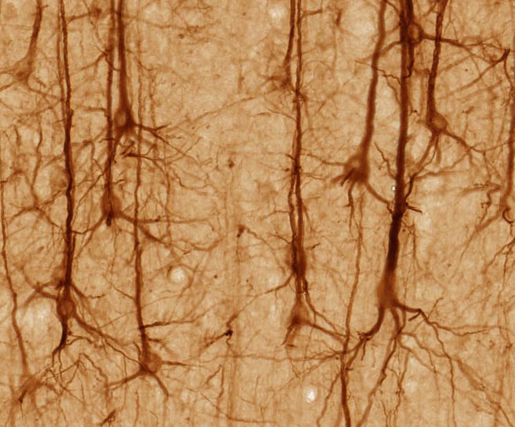
Perceptron model
Stained Neurons in cerebral cortex

Slide 11
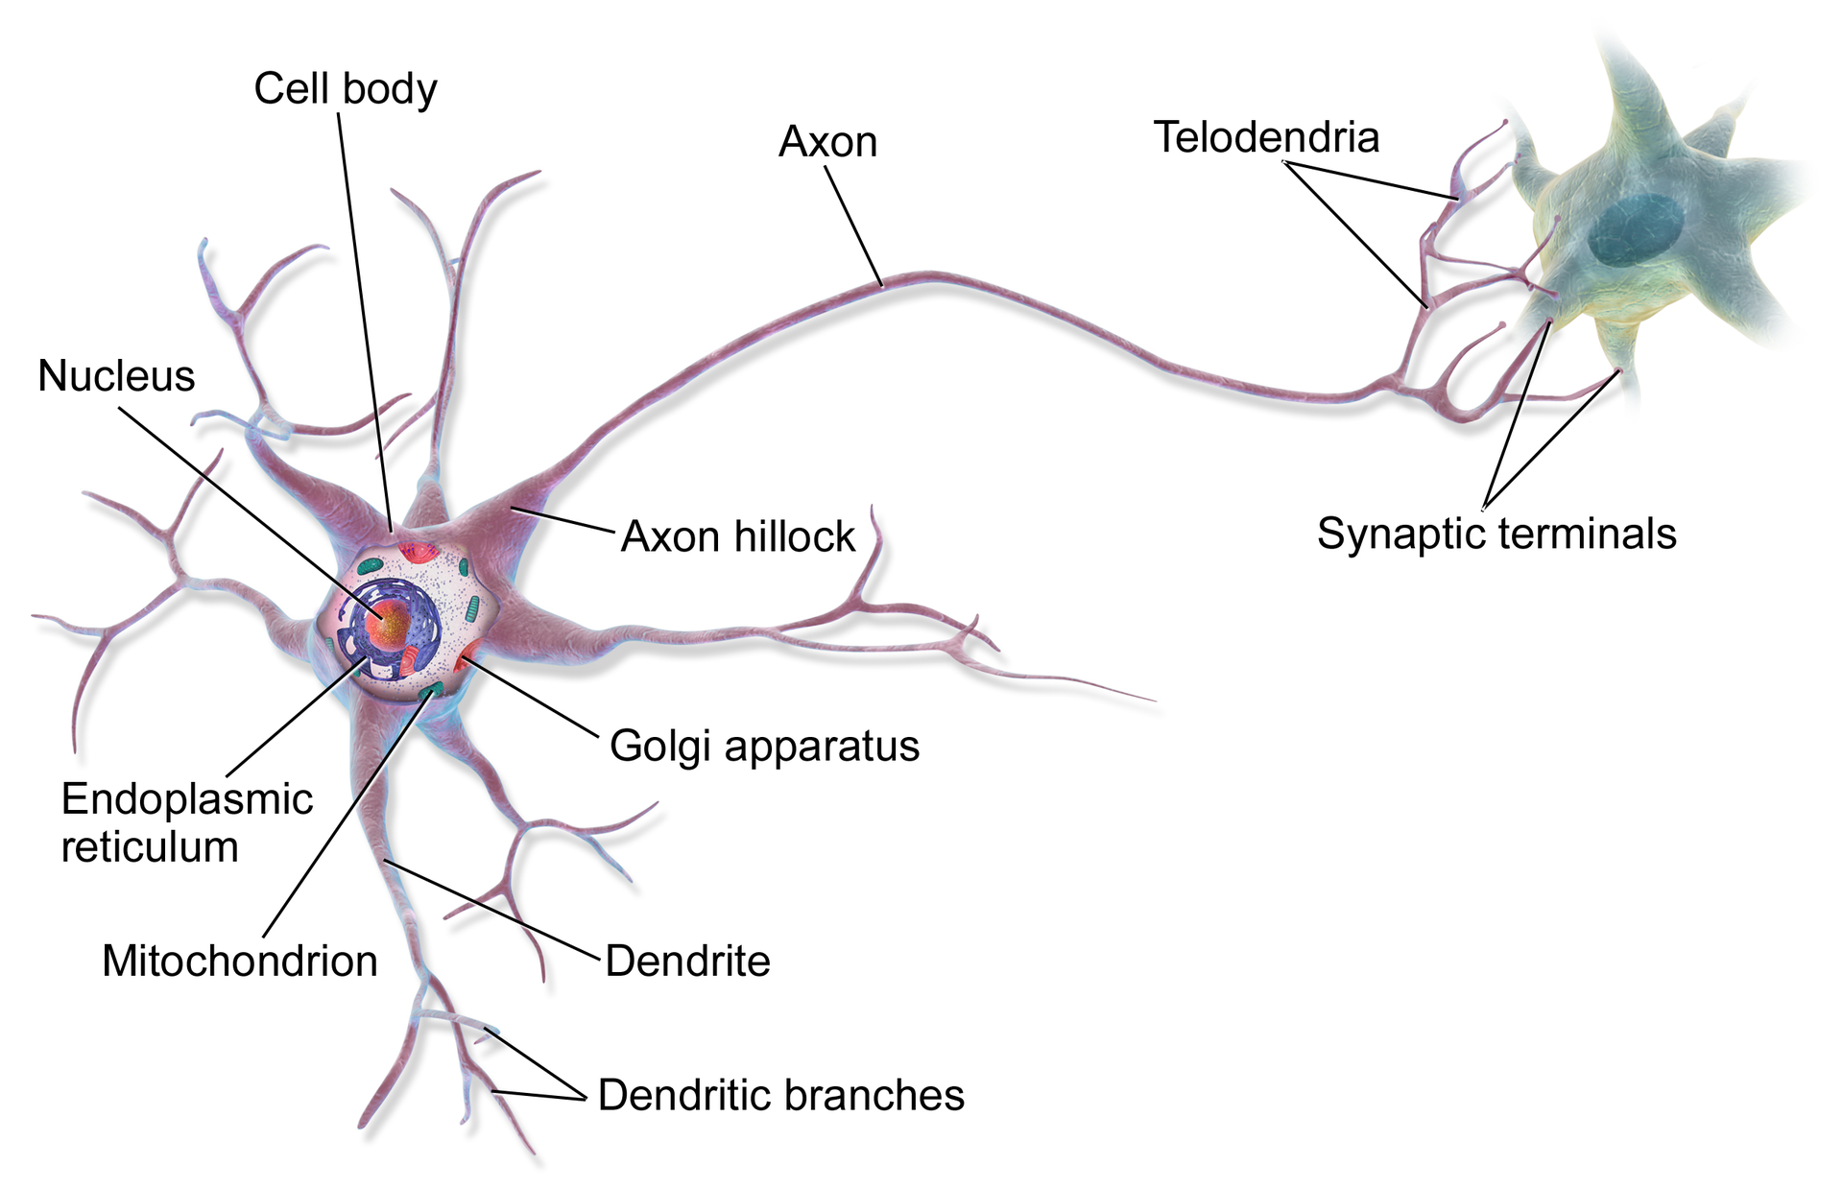
Perceptron model
Illustration of biological neurons

Slide 12
Perceptron model
Illustration of biological neurons

Slide 13
Perceptron model
Let’s really simplify this!

Slide 14
Perceptron model
Dendrites
Axon
Nucleus
Simplified Biological Neuron Model

Slide 15
Perceptron model
A perceptron was a form of neural network introduced in 1958 by Frank Rosenblatt.
Amazingly, even back then he saw huge potential:
"...perceptron may eventually be able to learn, make decisions, and translate languages."

Slide 16
Perceptron model
However, in 1969 Marvin Minsky and Seymour Papert's published their book Perceptrons.
It suggested that there were severe limitations to what perceptrons could do.
This marked the beginning of what is known as the AI Winter, with little funding into AI and Neural Networks in the 1970s.

Slide 17
Perceptron model
Fortunately for us, we now know the amazing power of neural networks, which all stem from the simple perceptron model, so let’s head back and convert our simple biological neuron model into the perceptron model.

Slide 18
Perceptron model
Dendrites
Axon
Nucleus
Perceptron Model

Slide 19
Perceptron model
Inputs
Output
Perceptron Model

Slide 20
Perceptron model
x1
Inputs
Output
x2
Let’s work through a simple example

Slide 21
Perceptron model
x1
Inputs
f(X)
Output
x2
Let’s work through a simple example

Slide 22
Perceptron model
x1
y
Inputs
f(X)
Output
x2
Let’s work through a simple example

Slide 23
Perceptron model
x1
y
Inputs
f(X)
Output
x2
If f(X) is just a sum, then y=x1+x2

Slide 24
Perceptron model
x1
y
Inputs
f(X)
Output
x2
Realistically, we would want to be able to adjust some parameter in order to “learn”

Slide 25
Perceptron model
w1
x1
y
Inputs
f(X)
Output
w2
x2
Let’s add an adjustable weight we multiply against x

Slide 26
Perceptron model
w1
x1
y
Inputs
f(X)
Output
w2
x2
Now y = x1w1 + x2w2

Slide 27
Perceptron model
w1
x1
y
Inputs
f(X)
Output
w2
x2
We could update the weights to effect y

Slide 28
Perceptron model
w1
x1
y
Inputs
f(X)
Output
w2
x2
But what if an x is zero? w won’t change anything!

Slide 29
Perceptron model
w1
x1
y
Inputs
f(X)
Output
w2
x2
Let’s add in a bias term b to the inputs.

Slide 30
Perceptron model
*w1 + b
x1
y
Inputs
f(X)
Output
x2
*w2 + b
Let’s add in a bias term b to the inputs.

Slide 31
Perceptron model
*w1 + b
x1
y
Inputs
f(X)
Output
x2
*w2 + b
y = (x1w1 + b) + (x2w2 + b)

Slide 32
Perceptron model
x1
*w1 + b
y
Inputs
f(X)
Output
x2
*w2 + b
xn
*wn + b
We can expand this to a generalization:

Slide 33
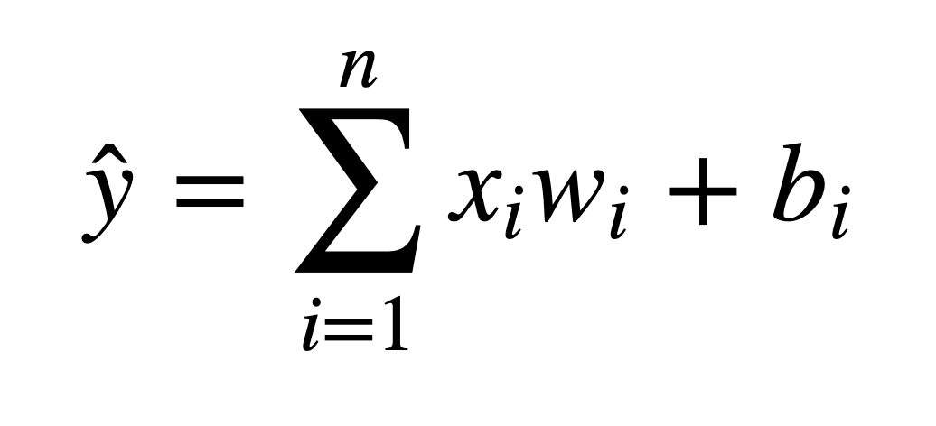
Perceptron model
We’ve been able to model a biological neuron as a simple perceptron! Mathematically our generalization was:

Slide 34
Perceptron model
Later on we will see how we can expand this model to have X be a tensor of information ( an n-dimensional matrix).

Slide 35
Perceptron model
Also we’ll see we can even simplify the bias to be at a layer level instead of a bias per input.

Slide 36
Perceptron model
x1
*w1 + b
y
Inputs
f(X)
Output
x2
*w2 + b
xn
*wn + b
Notice how at the end we sum a bunch of biases…

Slide 37
Perceptron model
x1
*w1 + b
y
Inputs
f(X)
Output
x2
*w2 + b
xn
*wn + b
Theoretically for any number of biases, there exists a bias that is the sum.

Slide 38
Perceptron model
x1
*w1
y
Inputs
f(X)
Output
x2
*w2
xn
*wn
B
Theoretically for any number of biases, there exists a bias that is the sum.

Slide 39
Perceptron model
x1
*w1
y
Inputs
f(X)
Output
x2
*w2
xn
*wn
B = b1 + b2 + … +bn
Theoretically for any number of biases, there exists a bias that is the sum.

Slide 40
Perceptron model
Let’s review what we learned:
We understand the very basics of a biological neuron
We saw how we can create a simple perceptron model replicating the core concepts behind a neuron.

Slide 41
Neural Networks

Slide 42
Neural Networks
A single perceptron won’t be enough to learn complicated systems.
Fortunately, we can expand on the idea of a single perceptron, to create a multi-layer perceptron model.

Slide 43
Neural Networks
A single perceptron won’t be enough to learn complicated systems.
Fortunately, we can expand on the idea of a single perceptron, to create a multi-layer perceptron model.
We’ll also introduce the idea of activation functions.

Slide 44
Neural Networks
To build a network of perceptrons, we can connect layers of perceptrons, using a multi-layer perceptron model.

Slide 45
Neural Networks
The outputs of one perceptron are directly fed into as inputs to another perceptron.

Slide 46
Neural Networks
This allows the network as a whole to learn about interactions and relationships between features.

Slide 47
Neural Networks
The first layer is the input layer

Slide 48
Neural Networks
The last layer is the output layer.
Note: This last layer can be more than one neuron

Slide 49
Neural Networks
Layers in between the input and output layers are the hidden layers.

Slide 50
Neural Networks
Hidden layers are difficult to interpret, due to their high interconnectivity and distance away from known input or output values.

Slide 51
Neural Networks
Neural Networks become “deep neural networks” if then contain 2 or more hidden layers.

Slide 52
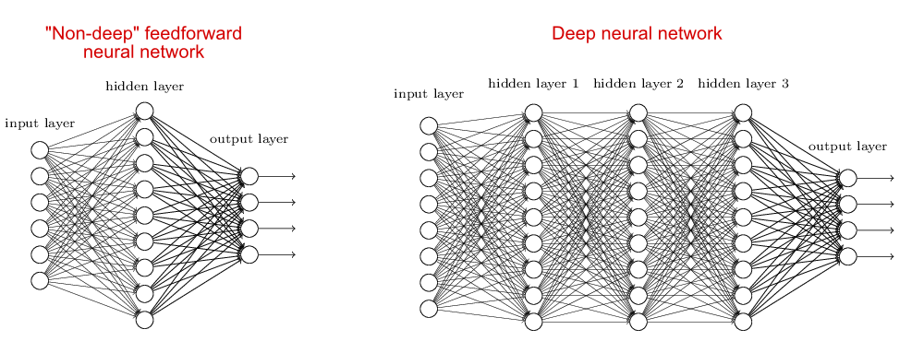
Neural Networks
Neural Networks become “deep neural networks” if then contain 2 or more hidden layers.

Slide 53
Neural Networks
Terminology:
Input Layer: First layer that directly accepts real data values
Hidden Layer: Any layer between input and output layers
Output Layer: The final estimate of the output.

Slide 54
Neural Networks
What is incredible about the neural network framework is that it can be used to approximate any function.
Zhou Lu and later on Boris Hanin proved mathematically that Neural Networks can approximate any convex continuous function.

Slide 55
Neural Networks
For more details on this check out the Wikipedia page for “Universal Approximation Theorem”

Slide 56
Neural Networks
Previously in our simple model we saw that the perceptron itself contained a very simple summation function f(x).
For most use cases however that won’t be useful, we’ll want to be able to set constraints to our output values, especially in classification tasks.

Slide 57
Neural Networks
In a classification tasks, it would be useful to have all outputs fall between 0 and 1.
These values can then present probability assignments for each class.
In the next lecture, we’ll explore how to use activation functions to set boundaries to output values from the neuron.

Slide 58
Activation Functions

Slide 59
Neural Networks
Recall that inputs x have a weight w and a bias term b attached to them in the perceptron model.
Which means we have
x*w + b

Slide 60
Neural Networks
Which means we have
x*w + b
Clearly w implies how much weight or strength to give the incoming input.
We can think of b as an offset value, making x*w have to reach a certain threshold before having an effect.

Slide 61
Neural Networks
For example if b= -10
x*w + b
Then the effects of x*w won’t really start to overcome the bias until their product surpasses 10.
After that, then the effect is solely based on the value of w.
Thus the term “bias”

Slide 62
Neural Networks
Next we want to set boundaries for the overall output value of:
x*w + b
We can state:
z = x*w + b
And then pass z through some activation function to limit its value.

Slide 63
Neural Networks
A lot of research has been done into activation functions and their effectiveness.
Let’s explore some common activation functions.

Slide 64
Perceptron model
w1
x1
y
Inputs
f(X)
Output
w2
+b
x2
Recall our simple perceptron has an f(X)

Slide 65
Perceptron model
w1
x1
y
Inputs
f(X)
Output
w2
+b
x2
If we had a binary classification problem, we would want an output of either 0 or 1.

Slide 66
Neural Networks
To avoid confusion, let’s define the total inputs as a variable z.
Where z = wx + b
In this context, we’ll then refer to activation functions as f(z).
Keep in mind, you will often see these variables capitalized f(Z) or X to denote a tensor input consisting of multiple values.

Slide 67
Deep Learning
The most simple networks rely on a basic step function that outputs 0 or 1.
1
Output
0
0
z = wx + b

Slide 68
Deep Learning
Regardless of the values, this always outputs 0 or 1.
1
Output
0
0
z = wx + b

Slide 69
Deep Learning
This sort of function could be useful for classification (0 or 1 class).
1
Output
0
0
z = wx + b

Slide 70
Deep Learning
However this is a very “strong” function, since small changes aren’t reflected.
1
Output
0
0
z = wx + b

Slide 71
Deep Learning
There is just an immediate cut off that splits between 0 and 1.
1
Output
0
0
z = wx + b

Slide 72
Deep Learning
It would be nice if we could have a more dynamic function, for example the red line!
1
Output
0
0
z = wx + b

Slide 73
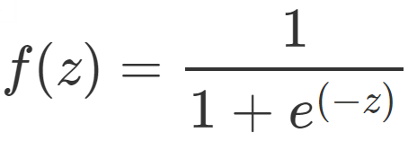
Deep Learning
Lucky for us, this is the sigmoid function!
1
Output
0
0
z = wx + b

Slide 74
Deep Learning
Changing the activation function used can be beneficial depending on the task!
1
Output
0
0
z = wx + b

Slide 75
Deep Learning
This still works for classification, and will be more sensitive to small changes.
1
Output
0
0
z = wx + b

Slide 76
Deep Learning
Let’s discuss a few more activation functions that we’ll encounter!
1
Output
0
0
z = wx + b

Slide 77
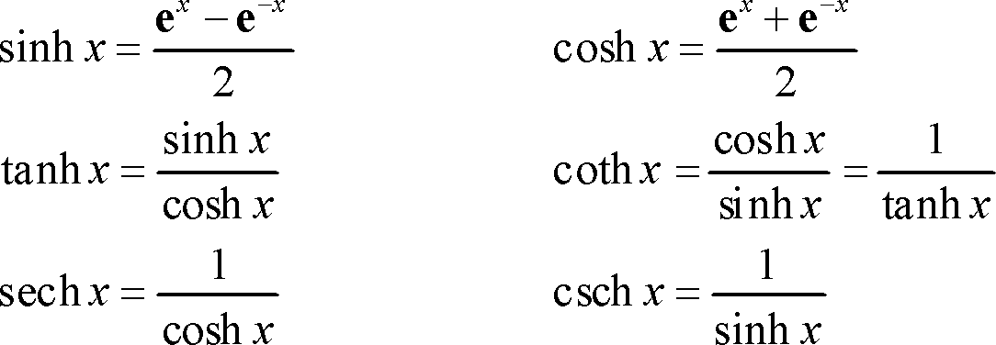
Deep Learning
Hyperbolic Tangent: tanh(z)
1
Output
-1
0

Slide 78
Deep Learning
Hyperbolic Tangent: tanh(z)
Outputs between -1 and 1 instead of 0 to 1
1
Output
-1
0

Slide 79
Deep Learning
Rectified Linear Unit (ReLU): This is actually a relatively simple function: max(0,z)
Output
0
z = wx + b

Slide 80
Deep Learning
ReLu has been found to have very good performance, especially when dealing with the issue of vanishing gradient.
We’ll often default to ReLu due to its overall good performance.

Slide 81
Deep Learning
For a full list of possible activation functions check out:
en.wikipedia.org/wiki/Activation_function

Slide 82
Multi-Class
Activation Functions

Slide 83
Deep Learning
Notice all these activation functions make sense for a single output, either a continuous label or trying to predict a binary classification (either a 0 or 1).
But what should we do if we have a multi-class situation?

Slide 84
Deep Learning
There are 2 main types of multi-class situations
Non-Exclusive Classes
A data point can have multiple classes/categories assigned to it
Mutually Exclusive Classes
Only one class per data point.

Slide 85
Deep Learning
Non-Exclusive Classes
A data point can have multiple classes/categories assigned to it
Photos can have multiple tags (e.g. beach, family, vacation, etc…)

Slide 86
Deep Learning
Mutually Exclusive Classes
A data point can only have one class/category assigned to it
Photos can be categorized as being in grayscale (black and white) or full color photos. A photo can not be both at the same time.

Slide 87
Deep Learning
Organizing Multiple Classes
The easiest way to organize multiple classes is to simply have 1 output node per class.

Slide 88
Neural Networks
Previously we thought of the last output layer as a single node.

Slide 89
Neural Networks
This single node could output a continuous regression value or binary classification (0 or 1).

Slide 90
Neural Networks
Let’s expand this output layer to work for the case of multi-classification.

Slide 91
Multiclass Classification
Organizing for Multiple Classes
Hidden Layers

Slide 92
Multiclass Classification
Organizing for Multiple Classes
Class One
Class Two
Hidden Layers
Class N

Slide 93
Deep Learning
Organizing Multiple Classes
This means we will need to organize categories for this output layer.
We can’t just have categories like “red”, “blue”, “green”, etc...

Slide 94
Deep Learning
Organizing Multiple Classes
Instead we use one-hot encoding
Let’s take a look at what this looks like for mutually exclusive classes.

Slide 95
Deep Learning
Mutually Exclusive Classes
Data Point 1 | RED
Data Point 2 | GREEN
Data Point 3 | BLUE
... | ...
Data Point N | RED

Slide 96
Deep Learning
Mutually Exclusive Classes
 | RED | GREEN | BLUE
Data Point 1 | 1 | 0 | 0
Data Point 2 | 0 | 1 | 0
Data Point 3 | 0 | 0 | 1
... | ... | ... | ...
Data Point N | 1 | 0 | 0
Data Point 1 | RED
Data Point 2 | GREEN
Data Point 3 | BLUE
... | ...
Data Point N | RED

Slide 97
Deep Learning
Non-Exclusive Classes
 | A | B | C
Data Point 1 | 1 | 1 | 0
Data Point 2 | 1 | 0 | 0
Data Point 3 | 0 | 1 | 1
... | ... | ... | ...
Data Point N | 0 | 1 | 0
Data Point 1 | A,B
Data Point 2 | A
Data Point 3 | C,B
... | ...
Data Point N | B

Slide 98
Deep Learning
Now that we have our data correctly organized, we just need to choose the correct classification activation function that the last output layer should have.

Slide 99
Deep Learning
Non-exclusive
Sigmoid function
Each neuron will output a value between 0 and 1, indicating the probability of having that class assigned to it.

Slide 100
Multiclass Classification
Sigmoid Function for Non-Exclusive Classes
Class One
Class Two
Hidden Layers
Class N

Slide 101
Multiclass Classification
Sigmoid Function for Non-Exclusive Classes
1
Class One
0.8
0
1
Class Two
0.2
0
Hidden Layers
1
Class N
0.3
0

Slide 102
Multiclass Classification
Sigmoid Function for Non-Exclusive Classes
1
Class One
0.8
0
1
Class Two
0.6
0
Hidden Layers
1
Class N
0.2
0

Slide 103
Deep Learning
Non-exclusive
Sigmoid function
Keep in mind this allows each neuron to output independent of the other classes, allowing for a single data point fed into the function to have multiple classes assigned to it.

Slide 104
Deep Learning
Mutually Exclusive Classes
But what do we do when each data point can only have a single class assigned to it?
We can use the softmax function for this!

Slide 105
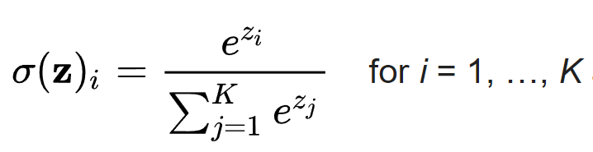
Deep Learning
Softmax Function

Slide 106
Deep Learning
Mutually Exclusive Classes
Softmax function calculates the probabilities distribution of the event over K different events.
This function will calculate the probabilities of each target class over all possible target classes.

Slide 107
Deep Learning
Mutually Exclusive Classes
The range will be 0 to 1, and the sum of all the probabilities will be equal to one.
The model returns the probabilities of each class and the target class chosen will have the highest probability.

Slide 108
Deep Learning
Mutually Exclusive Classes
The main thing to keep in mind is that if you use softmax for multi-class problems you get this sort of output:
[Red , Green , Blue]
[ 0.1 , 0.6 , 0.3 ]

Slide 109
Deep Learning
Mutually Exclusive Classes
The probabilities for each class all sum up to 1. We choose the highest probability as our assignment.
[Red , Green , Blue]
[ 0.1 , 0.6 , 0.3 ]

Slide 110
Deep Learning
Review
Perceptrons expanded to neural network model
Weights and Biases
Activation Functions
Time to learn about Cost Functions!

Slide 111
Cost Functions and Gradient Descent

Slide 112
Deep Learning
We now understand that neural networks take in inputs, multiply them by weights, and add biases to them.
Then this result is passed through an activation function which at the end of all the layers leads to some output.

Slide 113
Deep Learning
This output ŷ is the model’s estimation of what it predicts the label to be.
So after the network creates its prediction, how do we evaluate it?
And after the evaluation how can we update the network’s weights and biases?

Slide 114
Deep Learning
We need to take the estimated outputs of the network and then compare them to the real values of the label.
Keep in mind this is using the training data set during the fitting/training of the model.

Slide 115
Deep Learning
The cost function (often referred to as a loss function) must be an average so it can output a single value.
We can keep track of our loss/cost during training to monitor network performance.

Slide 116
Deep Learning
We’ll use the following variables:
y to represent the true value
a to represent neuron’s prediction
In terms of weights and bias:
w*x + b = z
Pass z into activation function σ(z) = a

Slide 117
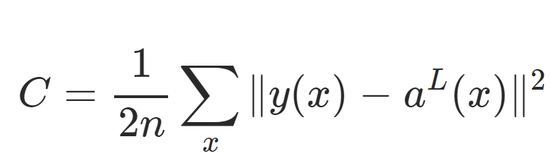
Deep Learning
One very common cost function is the quadratic cost function:

Slide 118
Deep Learning
We simply calculate the difference between the real values y(x) against our predicted values a(x).

Slide 119
Deep Learning
Note: The notation shown here corresponds to vector inputs and outputs, since we will be dealing with a batch of training points and predictions.

Slide 120
Deep Learning
Notice how squaring this does 2 useful things for us, keeps everything positive and punishes large errors!

Slide 121
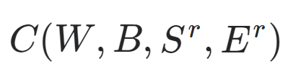
Deep Learning
We can think of the cost function as:

Slide 122
Deep Learning
W is our neural network's weights, B is our neural network's biases, S^{r} is the input of a single training sample, and E^{r} is the desired output of that training sample.

Slide 123
Deep Learning
Notice how that information was all encoded in our simplified notation.
The a(x) holds information about weights and biases.

Slide 124
Deep Learning
This means that if we have a huge network, we can expect C to be quite complex, with huge vectors of weights and biases.

Slide 125
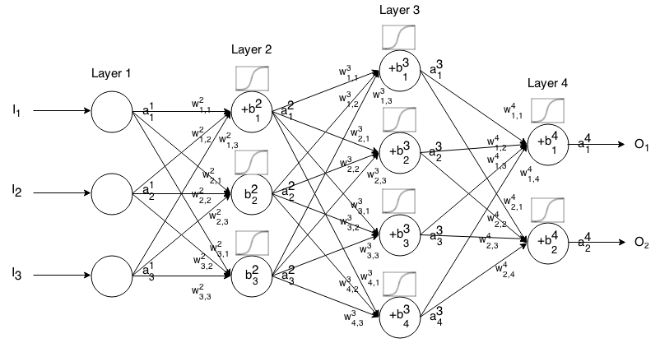
Deep Learning
Here is a small network with all its parameters labeled:

Slide 126
Deep Learning
That is a lot to calculate!
How do we solve this?

Slide 127
Deep Learning
In a real case, this means we have some cost function C dependent lots of weights!
C(w1,w2,w3,....wn)
How do we figure out which weights lead us to the lowest cost?

Slide 128
Deep Learning
For simplicity, let’s imagine we only had one weight in our cost function w.
We want to minimize our loss/cost (overall error).
Which means we need to figure out what value of w results in the minimum of C(w)

Slide 129
Deep Learning
Our “simple” function C(w)
C(w)
w

Slide 130
Deep Learning
What value of w minimizes our cost?
C(w)
w

Slide 131
Deep Learning
What value of w minimizes our cost?
C(w)
w

Slide 132
Deep Learning
What value of w minimizes our cost?
C(w)
w
wmin

Slide 133
Deep Learning
Students of calculus know we could take a derivative and solve for 0.
C(w)
w
wmin

Slide 134
Deep Learning
But recall our real cost function will be very complex!
C(w)
w

Slide 135
Deep Learning
And it will be n-dimensional!
C(w)
w

Slide 136
Deep Learning
And it will be n-dimensional since our networks will have 1000s of weights
C(w)
w

Slide 137
Deep Learning
We can use gradient descent to solve this problem.
C(w)
w

Slide 138
Deep Learning
Let’s go back to our simplified version to see how this works.
C(w)
w
wmin

Slide 139
Deep Learning
We can calculate the slope at a point
C(w)
w
wmin

Slide 140
Deep Learning
We can calculate the slope at a point
C(w)
w
wmin

Slide 141
Deep Learning
Then we move in the downward direction of the slope.
C(w)
w
wmin

Slide 142
Deep Learning
Then we move in the downward direction of the slope.
C(w)
w
wmin

Slide 143
Deep Learning
Then we move in the downward direction of the slope.
C(w)
w
wmin

Slide 144
Deep Learning
Until we converge to zero, indicating a minimum.
C(w)
w
wmin

Slide 145
Deep Learning
We could have changed our step size to find the next point!
C(w)
w
wmin

Slide 146
Deep Learning
Our steps:
C(w)
w
wmin

Slide 147
Deep Learning
Smaller steps sizes take longer to find the minimum.
C(w)
w
wmin

Slide 148
Deep Learning
Larger steps are faster, but we risk overshooting the minimum!
C(w)
w
wmin

Slide 149
Deep Learning
This step size is known as the learning rate.
C(w)
w
wmin

Slide 150
Deep Learning
The learning rate we showed in our illustrations was constant (each step size was equal)
But we can be clever and adapt our step size as we go along.

Slide 151
Deep Learning
We could start with larger steps, then go smaller as we realize the slope gets closer to zero.
This is known as adaptive gradient descent.

Slide 152
Deep Learning
In 2015, Kingma and Ba published their paper: “Adam: A Method for Stochastic Optimization“.
Adam is a much more efficient way of searching for these minimums, so you will see us use it for our code!

Slide 153
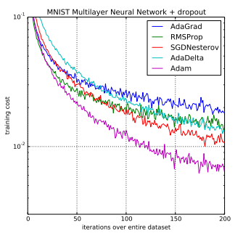
Deep Learning
Adam versus other gradient descent algorithms:

Slide 154
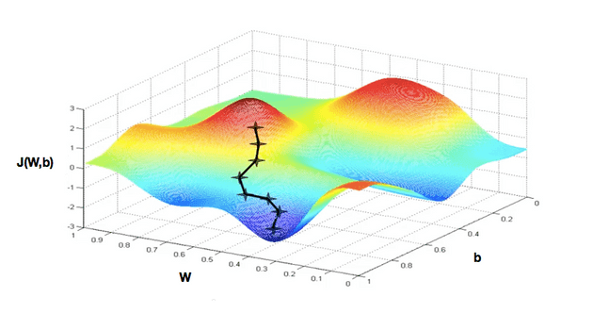
Deep Learning
Realistically we’re calculating this descent in an n-dimensional space for all our weights.

Slide 155
Deep Learning
When dealing with these N-dimensional vectors (tensors), the notation changes from derivative to gradient.
This means we calculate ∇C(w1,w2,...wn)

Slide 156
Deep Learning
For classification problems, we often use the cross entropy loss function.
The assumption is that your model predicts a probability distribution p(y=i) for each class i=1,2,…,C.

Slide 157

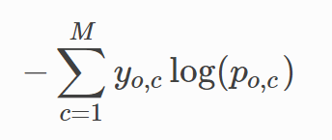
Deep Learning
For a binary classification this results in:
For M number of classes > 2

Slide 158
Deep Learning
Review:
Cost Functions
Gradient Descent
Adam Optimizer
Quadratic Cost and Cross-Entropy

Slide 159
Deep Learning
So far we understand how networks can take in input , effect that input with weights, biases, and activation functions to produce an estimated output.
Then we learned how to evaluate that output.

Slide 160
Deep Learning
The last thing we need to learn about theory is:
Once we get our cost/loss value, how do we actually go back and adjust our weights and biases?
This is backpropagation, and it is what we are going to cover next!

Slide 161
Backpropagation

Slide 162
Deep Learning
The last theory topic we will cover is backpropagation.
We’ll start by building an intuition behind backpropagation, and then we’ll dive into the calculus and notation of backpropagation.

Slide 163
Deep Learning
Fundamentally, we want to know how the cost function results changes with respect to the weights in the network, so we can update the weights to minimize the cost function

Slide 164
Deep Learning
Let’s begin with a very simple network, where each layer only has 1 neuron

Slide 165
Deep Learning
Each input will receive a weight and bias
w1 +b1
w2 +b2
w3 +b3

Slide 166
Deep Learning
This means we have:
C(w1,b1,w2,b2,w3,b3)
w1 +b1
w2 +b2
w3 +b3

Slide 167
Deep Learning
We’ve already seen how this process propagates forward.
Let’s start at the end to see the backpropagation.
w1 +b1
w2 +b2
w3 +b3

Slide 168
Deep Learning
Let’s say we have L layers, then our notation becomes:
L-n
L-2
L-1
L

Slide 169
Deep Learning
Focusing on these last two layers, let’s define z=wx+b
Then applying an activation function we’ll state: a = σ(z)
L-1
L

Slide 170
Deep Learning
This means we have:
z^{L} = w^{L} a^{L-1} +b^{L}
L-1
L

Slide 171
Deep Learning
This means we have:
z^{L} = w^{L} a^{L-1} +b^{L}
a^{L} = σ(z^{L})
L-1
L

Slide 172
Deep Learning
This means we have:
z^{L} = w^{L} a^{L-1} +b^{L}
a^{L} = σ(z^{L})
C₀(...) =(a^{L} - y)²
L-1
L

Slide 173
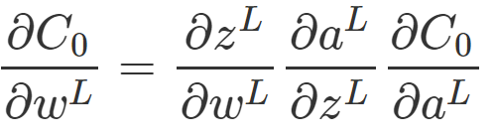
Deep Learning
We want to understand how sensitive is the cost function to changes in w:
L-1
L

Slide 174
Deep Learning
Using the relationships we already know along with the chain rule:
L-1
L

Slide 175
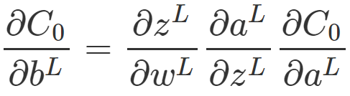

Deep Learning
We can calculate the same for the bias terms:
L-1
L

Slide 176
Deep Learning
The main idea here is that we can use the gradient to go back through the network and adjust our weights and biases to minimize the output of the error vector on the last output layer.

Slide 177
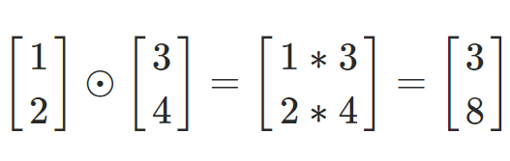
Deep Learning
Using some calculus notation, we can expand this idea to networks with multiple neurons per layer.
Hadamard Product

Slide 178
Deep Learning
Given this notation and backpropagation, we have a few main steps to training neural networks.
Note! You do not need to fully understand these intricate details to continue with the coding portions.

Slide 179
Deep Learning
Step 1: Using input x set the activation function a for the input layer.
z = w x +b
a = σ(z)
This resulting a then feeds into the next layer (and so on).

Slide 180
Deep Learning
Step 2: For each layer, compute:
z^{L} = w^{L} a^{L-1} +b^{L}
a^{L} = σ(z^{L})

Slide 181
Deep Learning
Step 3: We compute our error vector:
δ^{L}=∇_{a}C⊙σ′(z^{L})

Slide 182
Deep Learning
Step 3: We compute our error vector:
δ^{L}=∇_{a}C⊙σ′(z^{L})
∇_{a}C=(a^{L}−y)
Expressing the rate of change of C with respect to the output activations

Slide 183
Deep Learning
Step 3: We compute our error vector:
δ^{L}=(a^{L}−y)⊙σ′(z^{L})

Slide 184
Deep Learning
Step 3: We compute our error vector:
δ^{L}=(a^{L}−y)⊙σ′(z^{L})
Now let’s write out our error term for a layer in terms of the error of the next layer (since we’re moving backwards).
Font Note: lowercase L
Font Note: Number 1

Slide 185
Deep Learning
Step 4: Backpropagate the error:
For each layer: L−1,L−2,… we compute (note the lowercase L (l)):
δ^{l}=(w^{l+1})^{T}δ^{l+1}⊙σ′(z^{l})
(w^{l+1})^{T} is the transpose of the weight matrix of l+1 layer

Slide 186
Deep Learning
Step 4: Backpropagate the error:
This is the generalized error for any layer l:
δ^{l}=(w^{l+1})^{T}δ^{l+1}⊙σ′(z^{l})
(w^{l+1})^{T} is the transpose of the weight matrix of L+1 layer

Slide 187
Deep Learning
Step 4: When we apply the transpose weight matrix, (w^{l+1})^{T} we can think intuitively of this as moving the error backward through the network, giving us some sort of measure of the error at the output of the lth layer.

Slide 188
Deep Learning
Step 4: We then take the Hadamard product ⊙σ′(z^{l}). This moves the error backward through the activation function in layer l, giving us the error δ^{l} in the weighted input to layer l.

Slide 189
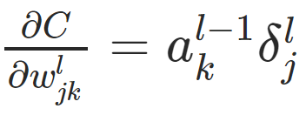
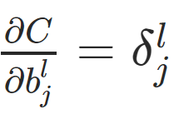
Deep Learning
The gradient of the cost function is given by:
For each layer: L−1,L−2,… we compute

Slide 190
Deep Learning
This then allows us to adjust the weights and biases to help minimize that cost function.
Check out the external links for more details!

Slide 191
TensorFlow and Keras

Slide 192
Deep Learning
Before we begin learning how to code our own neural networks, let’s quickly clarify the differences between TensorFlow and Keras!

Slide 193
Deep Learning
TensorFlow is an open-source deep learning library developed by Google, with TF 2.0 being officially released in late 2019.

Slide 194
Deep Learning
TensorFlow has a large ecosystem of related components, including libraries like Tensorboard, Deployment and Production APIs, and support for various programming languages.

Slide 195
Deep Learning
Keras is a high-level python library that can use a variety of deep learning libraries underneath, such as: TensorFlow, CNTK, or Theano.

Slide 196
Deep Learning
TensorFlow 1.x had a complex python class system for building models, and due to the huge popularity of Keras, when TF 2.0 was released, TF adopted Keras as the official API for TF.

Slide 197
Deep Learning
While Keras still also remains as a separate library from Tensorflow, it can also now officially be imported through TF, so there is now need to additionally install it.

Slide 198
Deep Learning
The Keras API is easy to use and builds models by simply adding layers on top of each other through simple calls.
Let’s now explore the basics of the Keras API for TensorFlow!

Slide 199
Keras Classification
Code Along - Part One

Slide 200
Deep Learning
This lecture will show how to perform a classification task with TensorFlow.
We will also focus on how to identify and deal with overfitting through Early Stopping Callbacks and Dropout Layers.

Slide 201
Deep Learning
Early Stopping
Keras can automatically stop training based on a loss condition on the validation data passed during the model.fit() call.

Slide 202
Deep Learning
Dropout Layers
Dropout can be added to layers to “turn off” neurons during training to prevent overfitting.

Slide 203
Deep Learning
Dropout Layers
Each Dropout layer will “drop” a user-defined percentage of neuron units in the previous layer every batch.

Slide 204
Introduction to Project

Slide 205
Deep Learning
It’s time for a project! You will build a model that will attempt to predict whether or not someone will pay back their loan based on historical information.

Slide 206
Deep Learning
You have 3 options for this project
Completely Solo
Exercise Guide Notebook
Code Along with Solution Lectures

Slide 207
Deep Learning
Completely Solo
Read the introduction in the Exercise notebook, then proceed with your own methods to build a predictive model.

Slide 208
Deep Learning
Exercise Guide Notebook
Follow the written steps in the notebook to complete tasks that guide you through building a predictive model.

Slide 209
Deep Learning
Code along with solutions lecture
Skip the next overview lecture and code along with us as we guide you through our solution video for the project.

Slide 210
Deep Learning
This is a large project!
To reflect a realistic situation, we will spend a lot of time performing feature engineering and analyzing our data.
Let’s explore the project guide notebook in the next lecture!

Slide 211
Keras Project
Exercise Solutions
Exploratory Data Analysis

Slide 212
Keras Project
Exercise Solutions
Data Preprocessing: Missing Data

Slide 213
Keras Project
Exercise Solutions
Categorical Data

Slide 214
Keras Project
Exercise Solutions
Data Preprocessing

Slide 215
Keras Project
Exercise Solutions
Creating and Training a Model

Slide 216
Keras Project
Exercise Solutions
Model Evaluation

Slide 217
Keras Project
Exercise Solutions
Model Evaluation

Slide 218
Tensorboard

Slide 219
Deep Learning
Tensorboard is a visualization tool from Google designed to work in conjunction with TensorFlow to visualize various aspects of your model.

Slide 220
Deep Learning
Here we will simply understand how to view the Tensorboard dashboard in our browser and analyze an existing model.
NOTE - This lecture requires that you understand file paths and the location of your notebook or .py file!

Slide 221
Deep Learning
Keep in mind, Tensorboard is a separate library from TensorFlow.
Google Collab Users can follow with Google’s official guide and pre-made notebook:
https://www.tensorflow.org/tensorboard/tensorboard_in_notebooks

